Slide 1
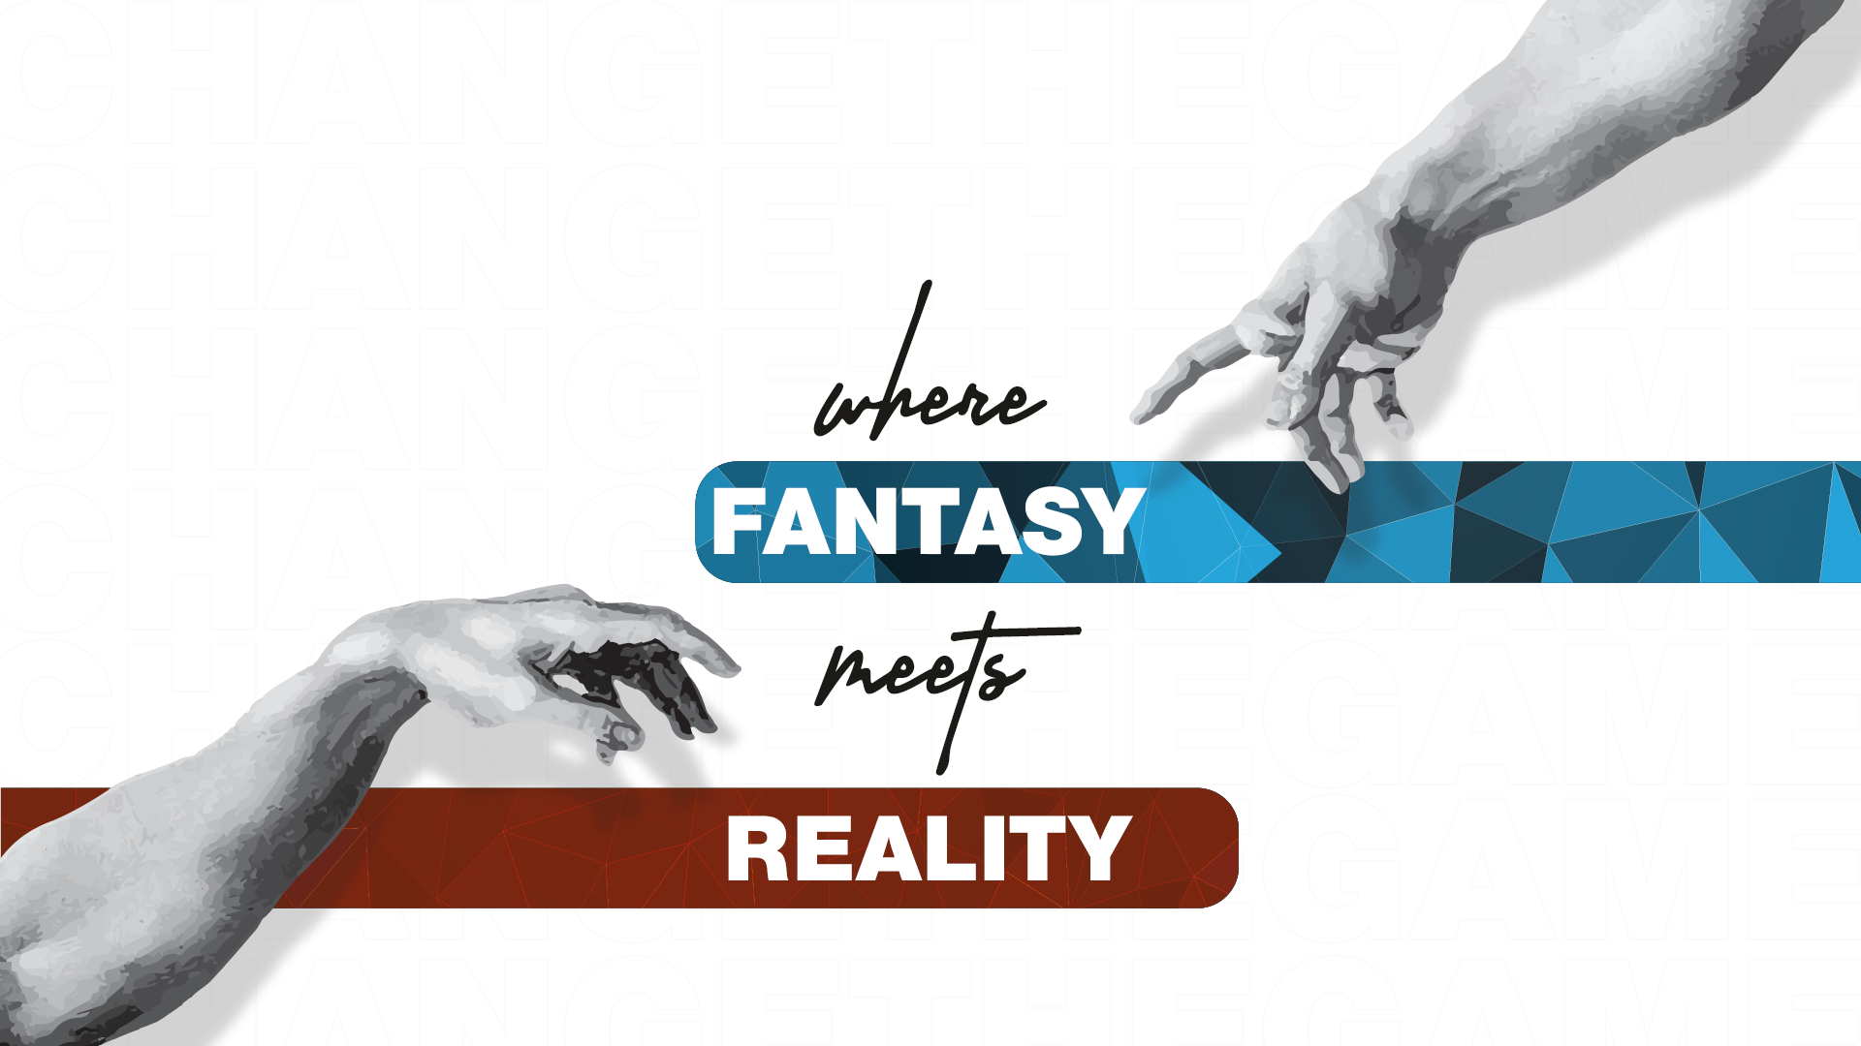


Slide 2

Lecture # 4

Slide 3

Introduction to CSS Part 3

Slide 4

FLEX ITEMS PROPERTIES
The flex item properties are:
order
flex-grow
flex-shrink
flex-basis
Flex

Slide 5
CSS GRID
Grid Layout
Grid Elements
Grid Columns
Grid Rows
Grid Gaps
Column-gap
Row-gap
Gap

Slide 6
CSS GRID
Grid column-start
Grid Column-end
Grid-Row,
Grid-Area,
Grid Container
Grid-template-columns
Grid-Template-rows
Justify-content
align-content

Slide 7
GRID LAYOUT
Explanation:
CSS Grid Layout is a system that allows you to design web layouts using a grid of rows and columns, providing a powerful and flexible way to structure your webpage.
Code Example:
.container {
display: grid;
grid-template-columns: 1fr 1fr 1fr;
grid-template-rows: auto;
}

Slide 8
GRIND ELEMENTS
Explanation:
Grid elements are the components placed inside a CSS Grid container. They can be any HTML elements like divs, images, or other containers.
Code Example:
<div class="container">
<div class="grid-item">Item 1</div>
<div class="grid-item">Item 2</div>
<div class="grid-item">Item 3</div>
</div>

Slide 9
GRID COLUMNS
Explanation:
Grid columns are the vertical sections of the grid that define how many columns exist in the layout.
Code Example:
Code Example:
.container {
display: grid;
grid-template-columns: 1fr 2fr 1fr;
}

Slide 10
GRID ROWS
Explanation:
Grid rows are the horizontal sections of the grid that define how many rows exist in the layout.
Code Example:
.container {
display: grid;
grid-template-rows: 100px auto 50px;
}

Slide 11
GRID GAPS
Explanation:
Grid gaps are the spaces between grid columns and rows,
providing spacing to improve readability.
Code Example:
.container {
display: grid;
grid-gap: 10px;
}

Slide 12
COLUMN-GAP AND ROW-GAP
Explanation:
column-gap and row-gap set specific gaps for columns
and rows, allowing fine-grained control over spacing.
.container {
display: grid;
column-gap: 20px;
row-gap: 10px;
}

Slide 13
GAP
Explanation:
gap is a shorthand property combining column-gap and row-gap for setting both column and row gaps.
Code Example:
.container {
display: grid;
gap: 15px 10px;
}

Slide 14
GRID COLUMN-START
Explanation:
grid-column-start specifies the starting position of
a grid item along the horizontal axis.
Code Example
.grid-item {
grid-column-start: 2;
}

Slide 15
GRIND COLUMN-END
Explanation:
grid-column-end specifies the ending position of a grid item along the horizontal axis.
Code Example:
.grid-item {
grid-column-start: 2;
grid-column-end: 4;
}

Slide 16
GRID CONTAINER
Explanation:
The grid container is an element with display: grid, containing grid items that form a grid layout.
Code Example:
.container {
display: grid;
grid-template-columns: 1fr 1fr;
}

Slide 17
GRID-TEMLAPTE-COLUMNS
Explanation:
grid-template-columns defines the number and size of columns in a grid container.
Code Example:
.container {
display: grid;
grid-template-columns: 1fr 2fr;
}

Slide 18
GRID-TEMLPATE-ROWS
Explanation:
grid-template-rows defines the number and size of rows in a grid container.
Code Example:
.container {
display: grid;
grid-template-rows: 100px auto;
}

Slide 19
JUSTIFY-CONTENT
Explanation:
justify-content aligns grid items along the horizontal axis of the grid container.
Code Example:
.container {
display: grid;
grid-template-columns: repeat(3, 1fr);
justify-content: space-around;
}

Slide 20
ALIGN-CONTENT
Explanation:
align-content aligns grid items along the vertical axis of the grid container.
Code Example:
.container {
display: grid;
grid-template-rows: repeat(3, 100px);
align-content: space-between;
}

Slide 21
GRID AREA
Explanation:
You can use the grid-area property to specify where to place an item.
The syntax is grid-row-start / grid-column-start / grid-row-end / grid-column-end.
Code Example
.grid-container {
display: grid;
grid-template-columns: auto auto auto auto;
grid-gap: 10px;
background-color: #2196F3;
padding: 10px;
}
.item1 {
grid-column-start: 4;
}

Slide 22
MEDIA QUERY
Explanation:
Media queries in CSS allow you to apply different styles for different devices and screen sizes. They enable responsive design, ensuring that your website looks good on various devices.
Key Points:
Media queries use the @media rule to apply styles based on specific conditions.
Conditions can include parameters like screen width, height, orientation, and more.
Common media query features include min-width, max-width, orientation, and device-pixel-ratio.
Media queries help create responsive designs by adjusting layout and styling for different devices.

Slide 23
CODE EXAMPLE
body {
font-size: 16px;
}
@media screen and (min-width: 600px) {
body {
font-size: 18px;
}
}
@media screen and (min-width: 1200px) {
body {
font-size: 20px;
}
}

Slide 24

Flex items Properties
The flex item properties are:
order
flex-grow
flex-shrink
flex-basis
flex

